Slide 1






CHAPTER 3. Concurrency, CPU Bound vs I/O Bound
동시성과 병렬성 배우기
Multiprocessing vs Threading vs AsyncIO
고수가 되는 파이썬
좋은사람

Slide 2







CHAPTER 3. Concurrency, CPU Bound vs I/O Bound
오늘 배울 내용
CPU Bound
I/O Bound
동시성 라이브러리 비교

Slide 3
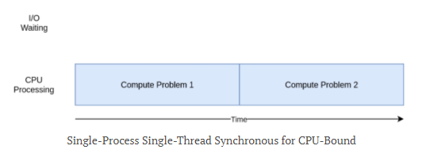
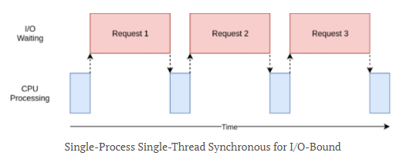
CPU-Bound
I/O-Bound
https://leimao.github.io/blog/Python-Concurrency-High-Level/

Slide 4
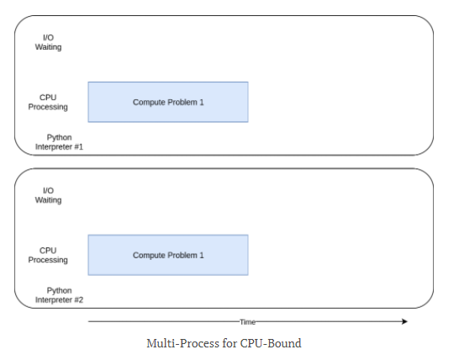
https://leimao.github.io/blog/Python-Concurrency-High-Level/

Slide 5
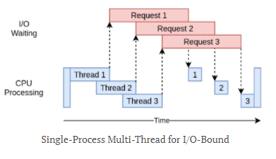
https://leimao.github.io/blog/Python-Concurrency-High-Level/

Slide 6
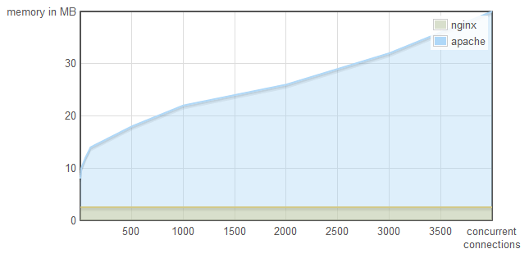
https://tech.ssut.me/python-3-play-with-asyncio/

Slide 7

CHAPTER 3. Concurrency, CPU Bound vs I/O Bound
감사합니다

